Slide 1

McGraw-Hill Technology Education
Copyright © 2006 by The McGraw-Hill Companies, Inc. All rights reserved.

Slide 2
LECTURE - 3
The Internet and the World Wide Web

Slide 3
The Internet’s History
1969 – ARPANET
  Developed by the Department of Defense
  Connected universities and defense bases
1973 – ARPANET connects to Europe
2A-<number>

Slide 4
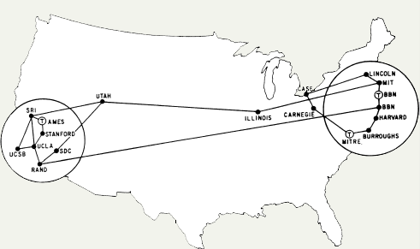
ARPANET 1973
2A-<number>

Slide 5
The Internet’s History
Mid-1980s – NSFNet
  Network between supercomputers
  Internet was the link to ARPANET
  No commercial traffic allowed
1990s
  ARPANET shut down
  NSFNet abandoned
  Commercial networks take over
2A-<number>
Notes:
Discussion point
Have students discuss the pros and cons of no central control for the Internet. Some discussion points can include copyright issues, free speech, advertisements and information access to all.

Slide 6
Today and the Future
100,000 new web sites per month
More than 50% of U.S. households online
Access is available throughout the U.S.
Eventually access will be global
2A-<number>

Slide 7
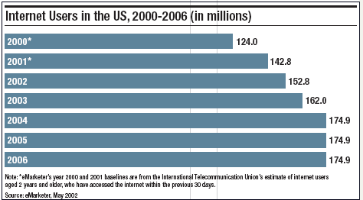
U.S. Internet Growth
2A-<number>

Slide 8
The Internet’s Major Services
The World Wide Web (WWW)
  Developed in 1993 by Tim-Berners Lee
  Allowed connection of documents
  Required a browser to read documents
Electronic mail (e-mail)
  Instantaneous transmission of documents
2A-<number>

Slide 9
The Internet’s Major Services
News
  Often called newsgroups
  Electronic discussions on several topics
File Transfer Protocol (FTP)
  Sends and receives files
2A-<number>
Notes:
Teaching tip
Show a typical news group to the students in class. Be sure that you have connected and downloaded all posts before trying the demonstration.
Demonstrate the use of ftp to change a web site.

Slide 10
The Internet’s Major Services
Chat
  Public real time conversation
Instant messaging
  Private real time conversation
Peer-to-peer services
  Allows sharing of files among users
  Napster and Kazaa are examples
  Illegal to share copyrighted material
2A-<number>
Notes:
Discussion point
Recently the pop artist Madonna posted several copies of her songs on Kazaa and other file sharing services. Instead of music, she talked at length about copyright infringement through music sharing. In retaliation, hackers hit her website and temporarily made her songs free to purchase. Who is right?

Slide 11
Accessing The Internet
Internet Service Provider (ISP)
  Company that provides Internet access
Dialup
  Connects to Internet through phone line
  Modem connects to the phone line
  Slow connection
2A-<number>

Slide 12
Accessing The Internet
High-speed access
  Connect through a special line
  2 – 25 times faster than dialup
  DSL, Cable, T1 are common
2A-<number>

Slide 13
Understanding the Internet
The Internet allows accessing resources
The Web simplifies the Internet
The Web connects documents
  Hypertext creates links between documents
  Documents are stored on a web server
  HTTP delivers documents
2A-<number>
Notes:
Teaching tip
Find out who has a web presence. If the site is appropriate, display it in class. Have the student discuss what is needed to establish and maintain a web presence.

Slide 14
Understanding the Internet
Web site is a collection of documents
  Document is a web page
  Pages are published to the web
Hypertext Markup Language
  Creates web pages
  Describes how pages should look
  Content enclosed in tags
  <tag>content</tag>
2A-<number>
Notes:
Teaching tip
Show your students how to access the HTML of an appropriate web site.

Slide 15
Understanding The Internet
Browsers
  Read and translate the HTML
  Display web content
Uniform Resource Locator (URL)
  Address of a web page
2A-<number>
Notes:
Teaching Tip
Dissect the URL provided.

Slide 16
Understanding The Internet
Helper applications
  Plug-ins
  Enhance a browser’s functionality
Streaming audio and video
  Sends the file in small chunks
  Chunks downloaded while others play
2A-<number>
Notes:
Teaching point
Direct the students to several different streaming video sites. Www.launch.com and www.apple.com/QuickTime are two excellent examples. Be sure your classroom browsers have the appropriate plug-ins.

Slide 17
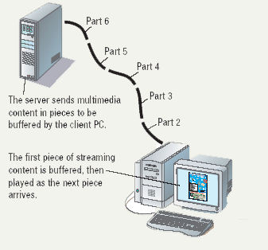
Streaming Audio
2A-<number>

Slide 18
Using a Browser And The WWW
Browser starts on the home page
Navigating the web
  Enter a URL in the browser
  Click a link
  Links are typically blue underlined words
  Image maps are picture links
When finished, close the browser
2A-<number>

Slide 19
Searching the Web
The Web is unorganized
Directories
  Categorize the Internet
Search engines
  Find sites by keyword
2A-<number>
Notes:
Insider information
The search engine www.google.com has become one of the hottest search engines on the planet. It is so popular, it’s name has become a verb. For example, “I googled the answer last night” is a phrase uttered on college campuses the world over.

Slide 20
Searching the Web
Site searches
  Large sites have an internal search
Metasearch sites
  Search several web sites at once
Sponsored links
  Sites pay for better search results
2A-<number>

Slide 21
Search Techniques
Quote the exact phrase
Use the keyword AND
Use the keyword NEAR
Avoid common words
Use the site’s advanced tools
2A-<number>

Slide 22
LECTURE - 4
Inputting Data In Other Ways

Slide 23

Devices for the Hand
Pen based input
  Tablet PCs, PDA
  Pen used to
  write data
  Pen used as
  a pointer
  Handwriting recognition
  On screen keyboard
3B-<number>
Notes:
Teaching tip
Microsoft has a demonstration of the tablet PC pen based input. Point your browser to http://www.microsoft.com/windowsxp/tabletpc/evaluation/tours/default.mspx and follow the tours.

Slide 24
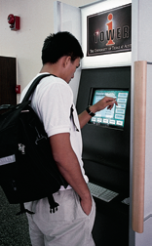
Devices for the hand
Touch screens
  Sensors determine where finger points
  Sensors create an X,Y coordinate
  Usually presents a menu to users
  Found in cramped or dirty environments
3B-<number>
Notes:
Discussion point
Discuss the information kiosks at local malls. Many offer limited Internet access. Have students discuss what could happen to the computers if the malls were to provide keyboards to the mall shoppers.

Slide 25

Devices for the hand
Game controllers
  Enhances gaming experience
  Provide custom input to the game
  Modern controllers offer feedback
  Joystick
  Game pad
3B-<number>
Notes:
Teaching tip
Microsoft’s Force Feedback joysticks vibrate. In driving games, when the player hits another car, the joystick will vibrate.

Slide 26
Optical Input Devices
Allows the computer to see input
Bar code readers
  Converts bar codes to numbers
    UPC code
  Computer find number in a database
  Works by reflecting light
    Amount of reflected light indicates number
3B-<number>
Notes:
Insider information
For more information on the UPC code and a searchable database, visit http://www.upcdatabase.com/. A working UPC is 071662000240, which represents a 24 count box of Crayola Crayons.

Slide 27
Optical Input Devices
Image scanners
  Converts printed media into electronic
  Reflects light off of the image
  Sensors read the intensity
  Filters determine color depths
3B-<number>
Notes:
Teaching tip
Spend a few minutes here discussing computer screen colors. A good website to look at colors is http://www.radok.com/web-safe-colors_rgb.html. To demonstrate how computers generate color, use the custom color creator in Paint.

Slide 28
Optical input devices
Optical character recognition (OCR)
  Converts scanned text into editable text
  Each letter is scanned
  Letters are compared to known letters
  Best match is entered into document
  Rarely 100% accurate
3B-<number>
Notes:
Teaching tip
Many companies ask for a plaintext resume. This is a resume, typed in Courier or other easy to read font, with no formatting. The intent is to allow the company to scan the resume for future searching. OCR technology makes this possible. For more information, see the website http://www.quintcareers.com/scannable_resumes.html.

Slide 29
Audiovisual Input Devices
Microphones
  Used to record speech
  Speech recognition
    “Understands” human speech
    Allows dictation or control of computer
    Matches spoken sound to known phonemes
    Enters best match into document
3B-<number>
Notes:
Insider information
Two common products are IBM’s Via Voice and Scansoft Dragon NaturallySpeaking. More information for ViaVoice can be found at http://www-306.ibm.com/software/voice/viavoice/. More information regarding Dragon is located at http://www.scansoft.com/naturallyspeaking/.

Slide 30
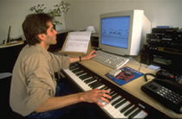
Audiovisual Input Devices
Musical Instrument Digital Interface
  MIDI
  Connects musical instruments to computer
  Digital recording or playback of music
  Musicians can produce professional results
3B-<number>

Slide 31
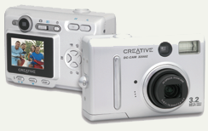
Audiovisual Input Devices
Digital cameras
  Captures images electronically
  No film is needed
  Image is stored as a JPG file
  Memory cards store the images
  Used in a variety of professions
3B-<number>

